Slide 1
Deep set neural network (Pytorch)
1
2
Chem
Berta
Final prediction NN
Deep layer
SMILES
1
SUM
BetaT,
GammaT,
BetaV,
GammaV
SMILES
2
Step 1: Tune only
2
Step 2: Fine-tune all
1
+
2

Slide 2
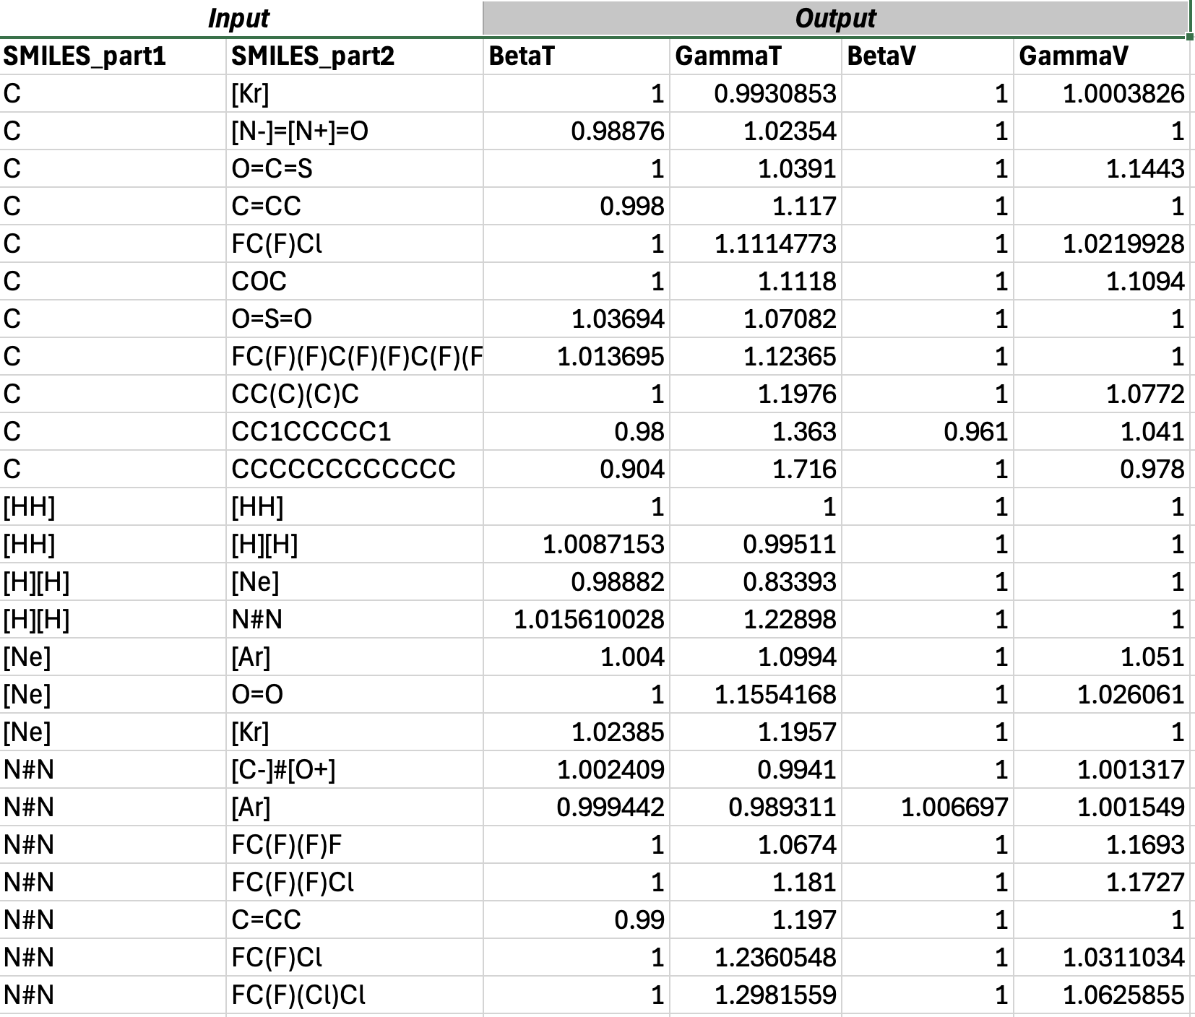
Training dataset of XR0 model
Chemical formula
SMILES code

Slide 3
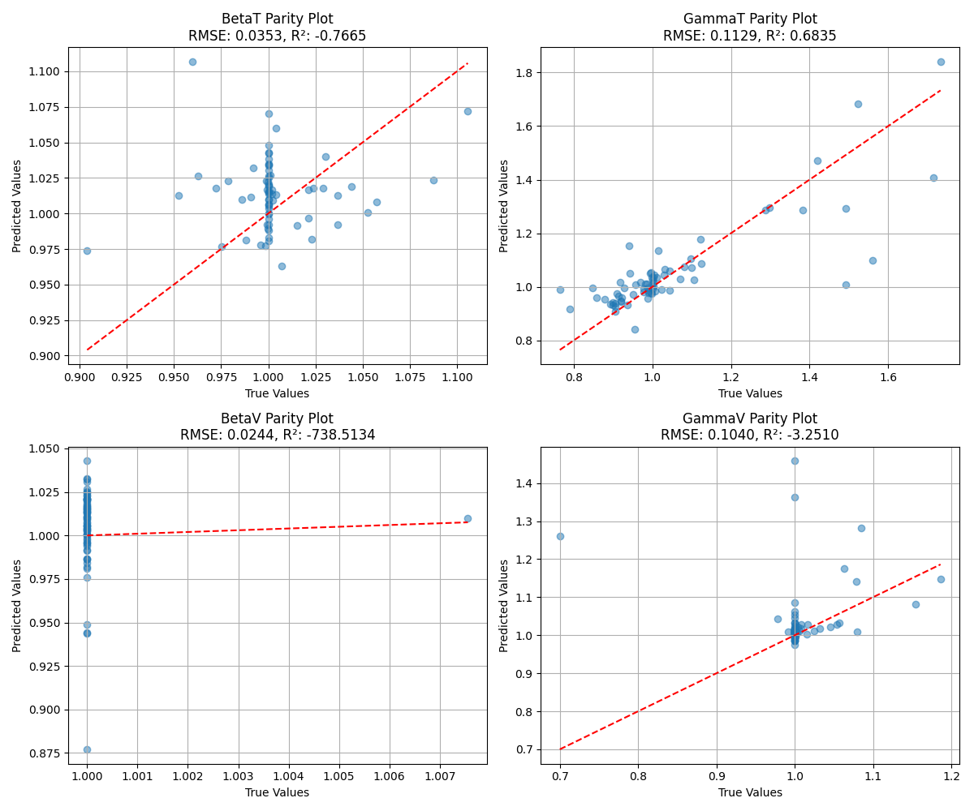
True vs Predicted coeffecient values for XR0 model
Argon/Neopentane
Argon/Ethanol

Slide 4
Argon/Neopentane
Argon/Ethanol

Slide 5
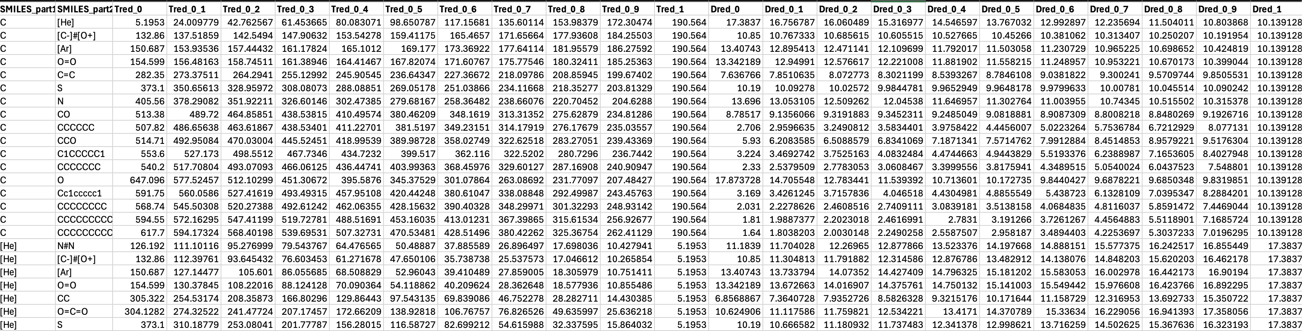
Training dataset of KW0 model
SMILES code
T Red (Molar ratio [X1:X2] (0 to 1))
D Red (Molar ratio [X1:X2] (0 to 1))

Slide 6
Helium/Isopentane
Hydrogen/Carbon monoxide

